Slide 1
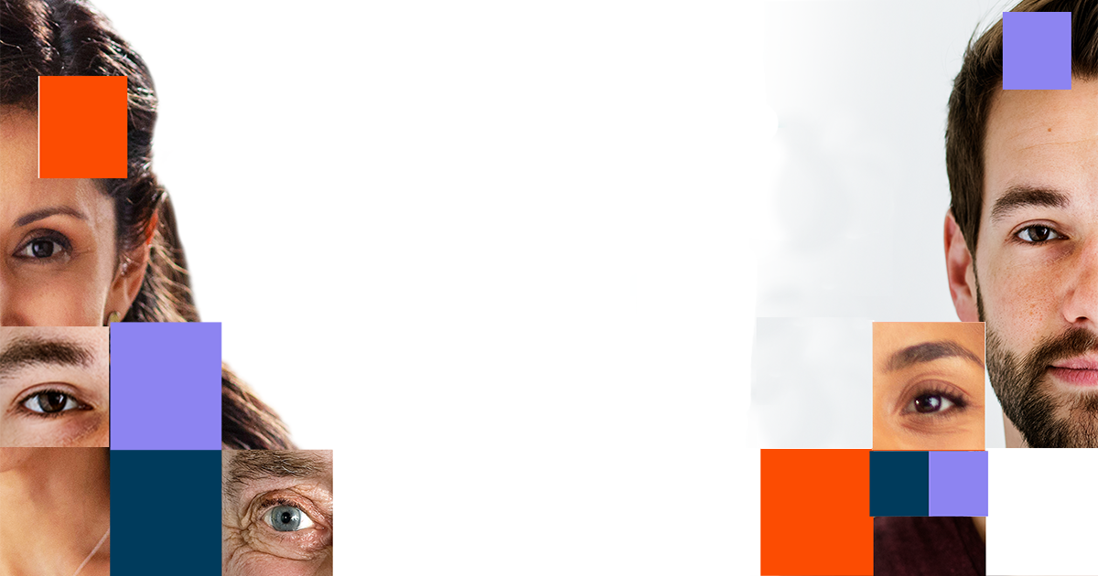
DEEPFAKE DETECTION
By
Ashwini Chaudhari (230340128006)
Sanjay jangid (230340128014)
Prathamesh Devkar (230340128018)
Yash Dube (230340128031)
Saif Mohammad (230340128023)
Guided by: Dr. Krishnanjan Sir

Slide 2
Contents
Introduction
System Architecture
Dataset Exploration
Pre Processing
Model Architecture
Training Workflow
Prediction Workflow
Tools and Technologies
Result
Demo
Conclusion

Slide 3

Introduction
In an era where digital media plays an increasingly central role in our lives, the emergence of deepfake technology raises critical concerns. Deepfakes are the manipulation of facial appearance through deep generative methods.
Deepfakes, cuttingedge of "deep learning" and "fake," refer to highly convincing and often indistinguishable synthetic media created using artificial intelligence (AI) techniques.
These media can include realistic-looking videos, images, audio, and even text, all manipulated to portray events and situations that never occurred.
Deepfakes are produced by employing generative adversarial networks (GANs), a sophisticated deep learning methodology, to merge and overlay pre-existing images and videos onto target source media, resulting in deceptive yet realistic simulations.

Slide 4
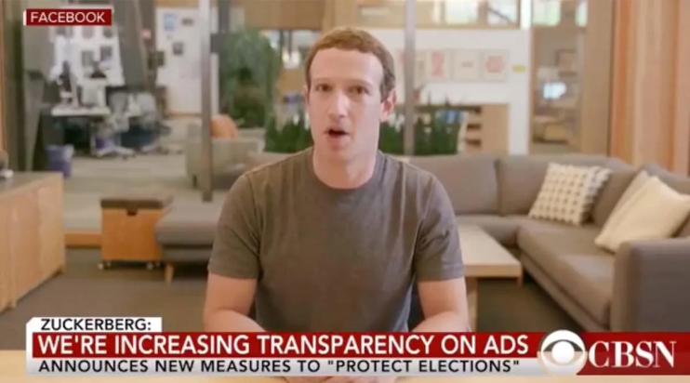
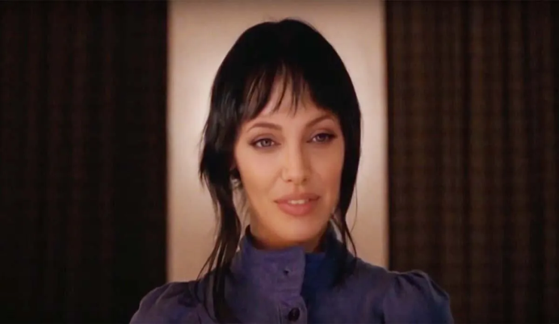
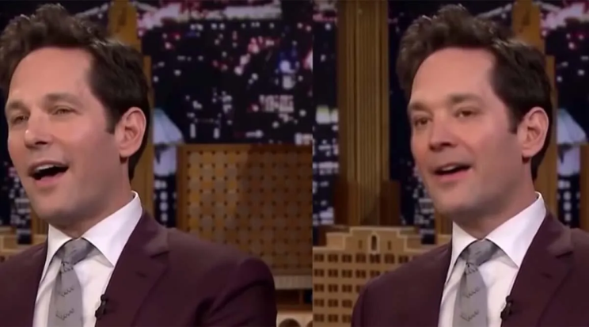
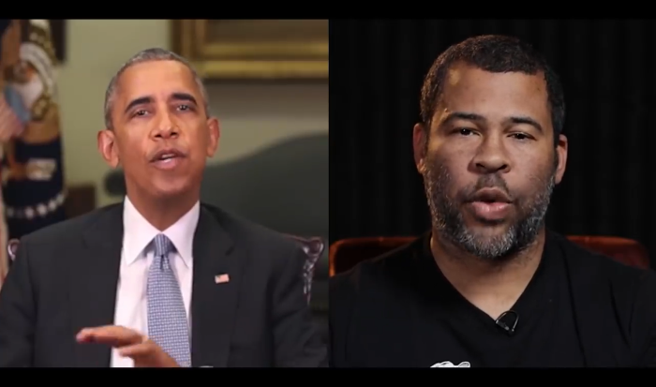
Dangers of Deepfakes
Fake News
Malicious hoaxes
Financial fraud
Celebrity unusual video
Revenge porn
Politician videos

Slide 5
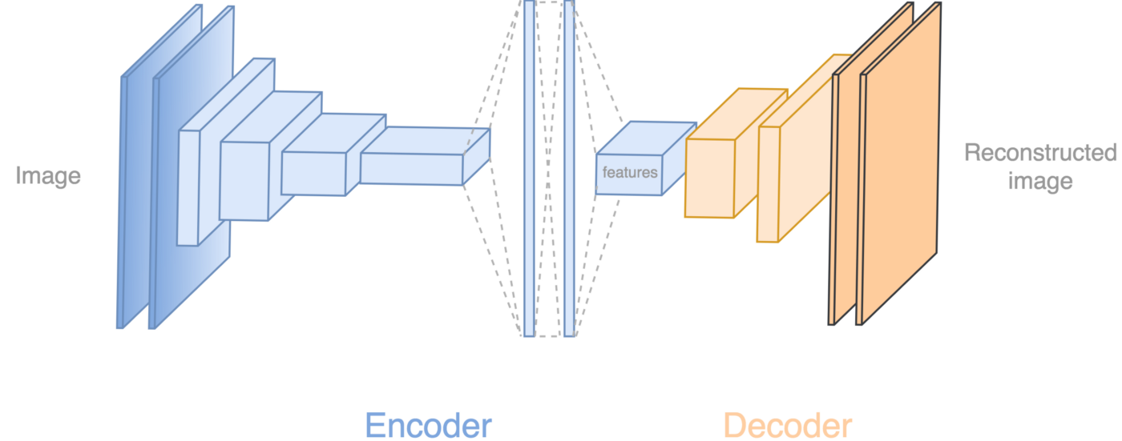
Deepfake Creation
Deepfake creation involves utilizing advanced artificial intelligence techniques, particularly generative adversarial networks (GANs), to manipulate and synthesize existing visual or auditory data. GANs consist of two neural networks — a generator and a discriminator — engaged in a competitive process.
The generator crafts highly realistic media by learning from a training dataset, while the discriminator distinguishes between authentic and generated content.
Tools for deep fake creation.
Faceswap
Faceit
DeepFaceLab
DeepfakeCapsuleGAN
Large resolution facemasked

Slide 6











Programming Languages
Python3
Programming Frameworks
TensorFlow
Tools and Technologies
IDE
Google
Jupyter Notebook
Stream Lit
Version Control
Git

Slide 7
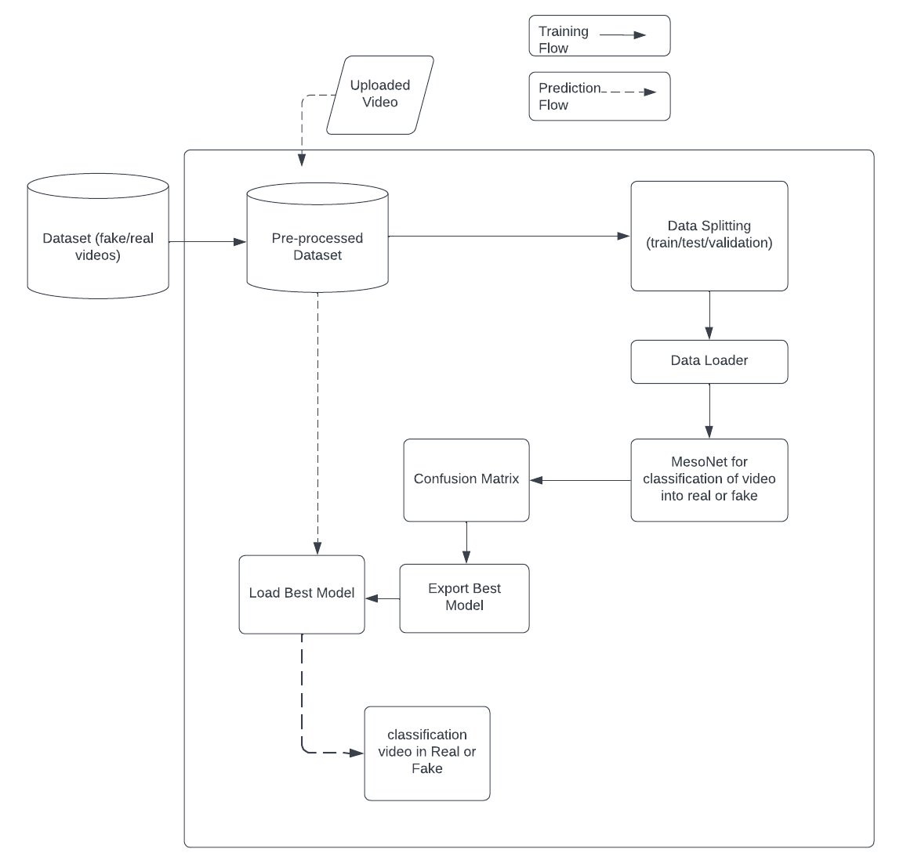
System Architecture

Slide 8
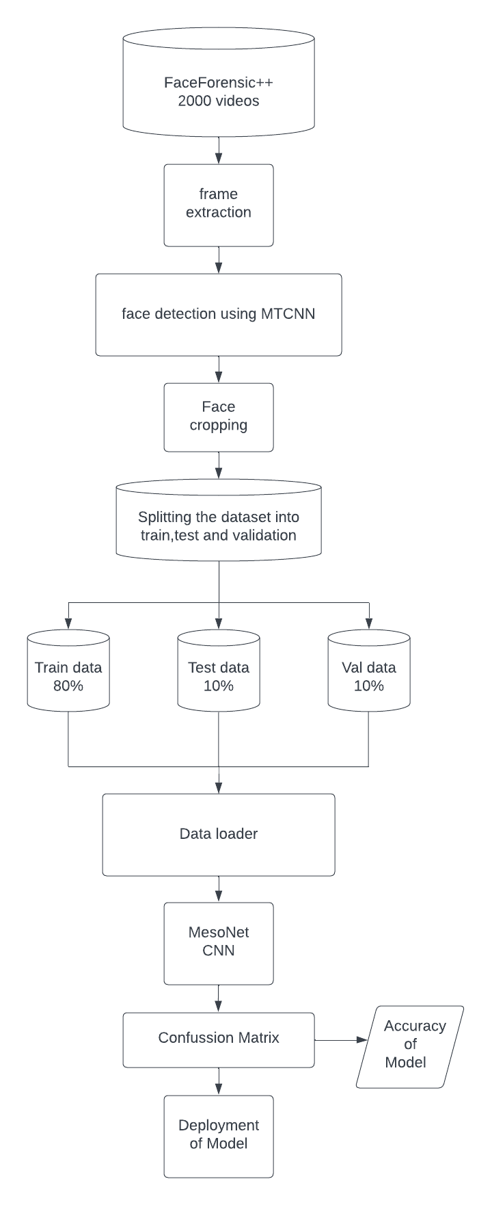
Data-set process chart

Slide 9
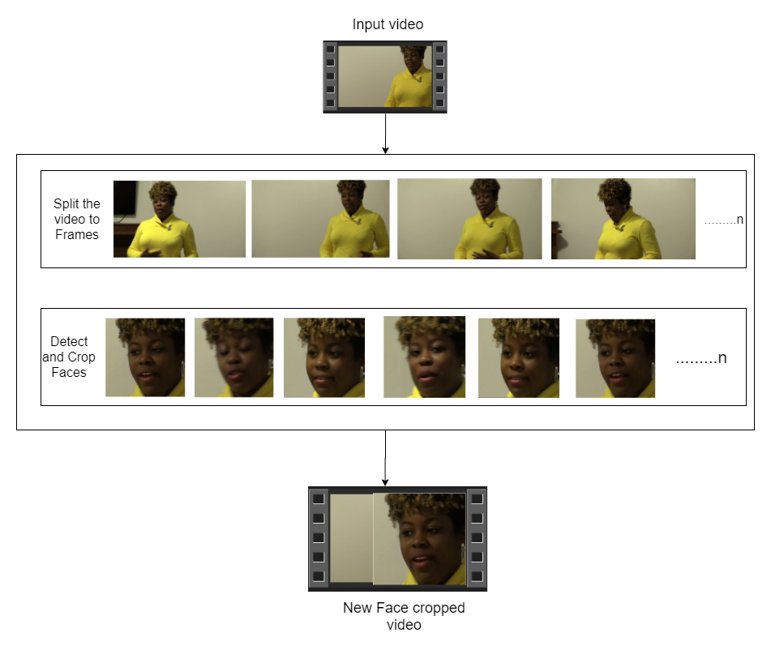
Pre-processing
Input video
Extraction of frames from video
Face detection and face cropping

Slide 10
Essential libraries
import cv2
from mtcnn import MTCNN
import splitfolders
import tensorflow as tf
from distutils.dir_util import copy_tree
from tensorflow.keras.preprocessing.image import ImageDataGenerator

Slide 11
Pre-processing code
converting video into frames :-
capture_image = cv.VideoCapture(video_path)
ret, frame = capture_image.read()
frame_rate = cap.get(5) #frame rate
if (frame_id % math.floor(frame_rate) == 0)
new_frame = cv2.resize(frame, dim, interpolation = cv2.INTER_AREA)
Face detection :-
detector = MTCNN()
image = cv2.cvtColor(cv2.imread(os.path.join(tmp_path, frame)), cv2.COLOR_BGR2RGB)
results = detector.detect_faces(image)
Face cropping:-
crop_image = image[y1:y2, x1:x2]

Slide 12
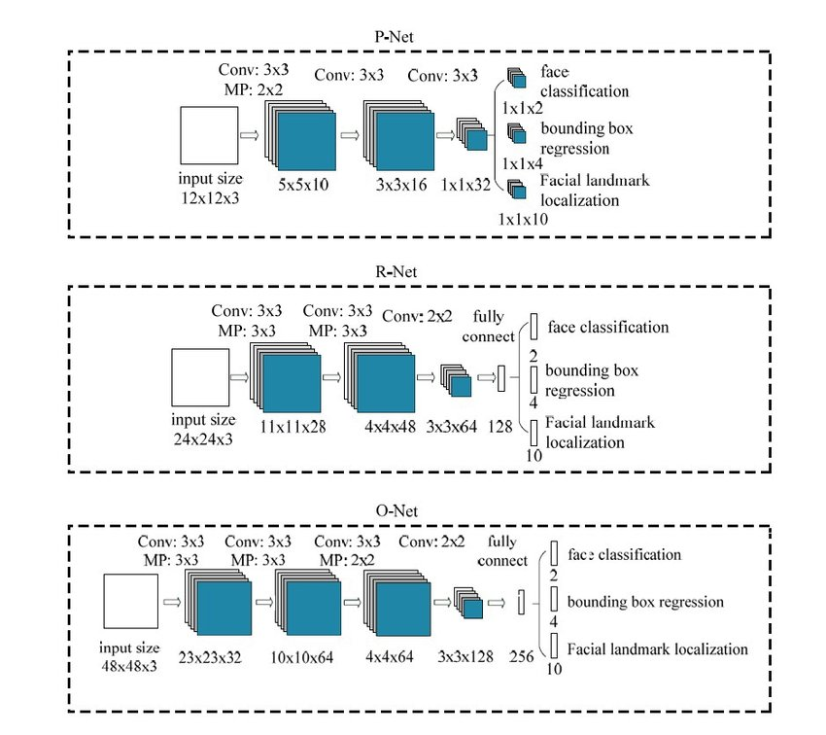
Model architecture-1
MTCNN architecture

Slide 13
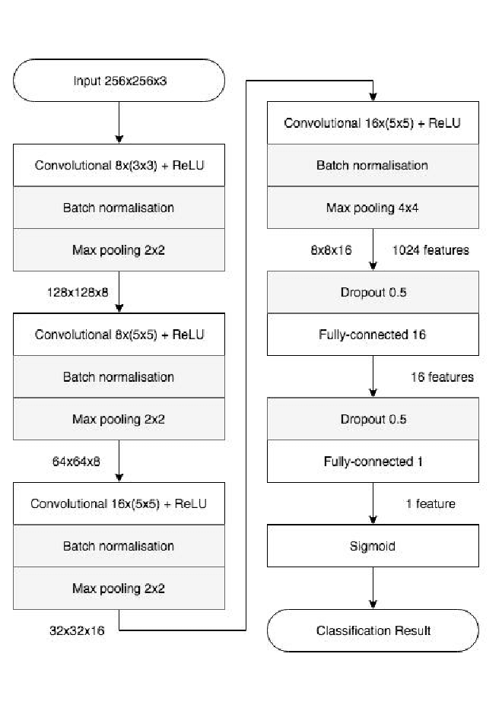
Model Architecture
MESONET Architecture:

Slide 14
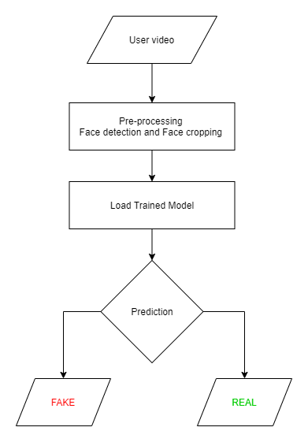
Prediction Workflow

Slide 15
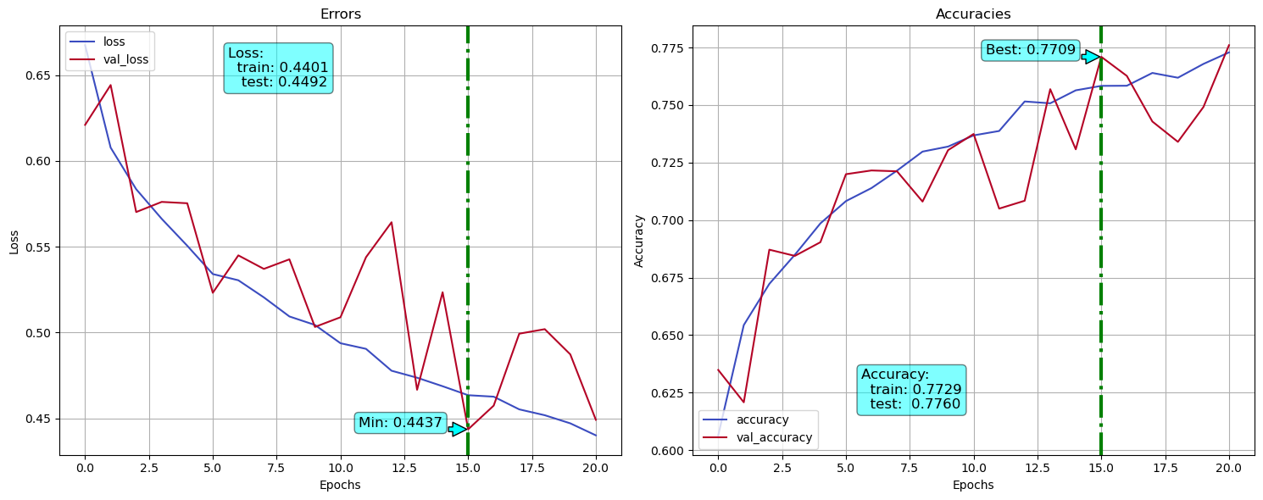
EfficientNet Prediction

Slide 16
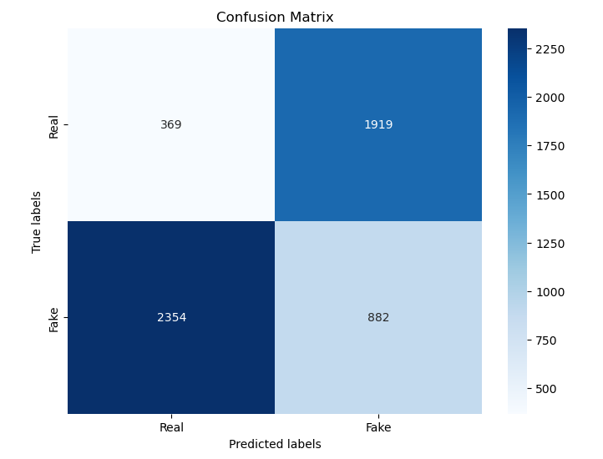
EfficientNet Confussion Matrix

Slide 17
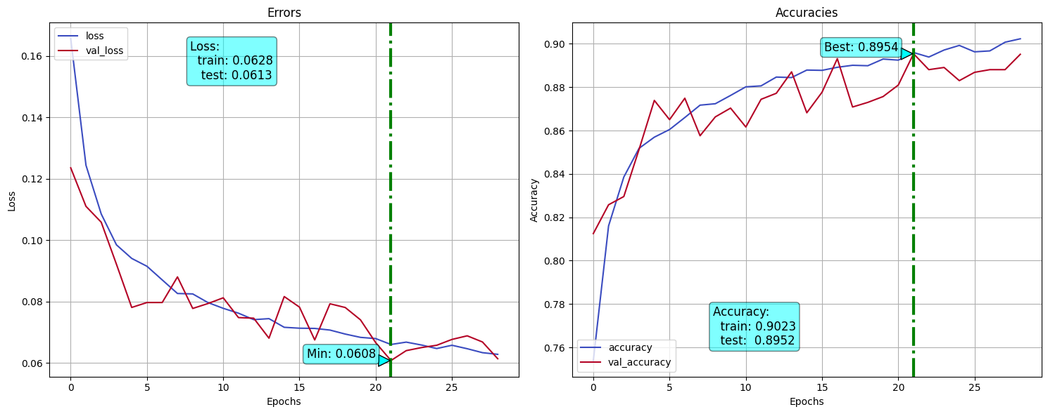
MesoNet Prediction

Slide 18
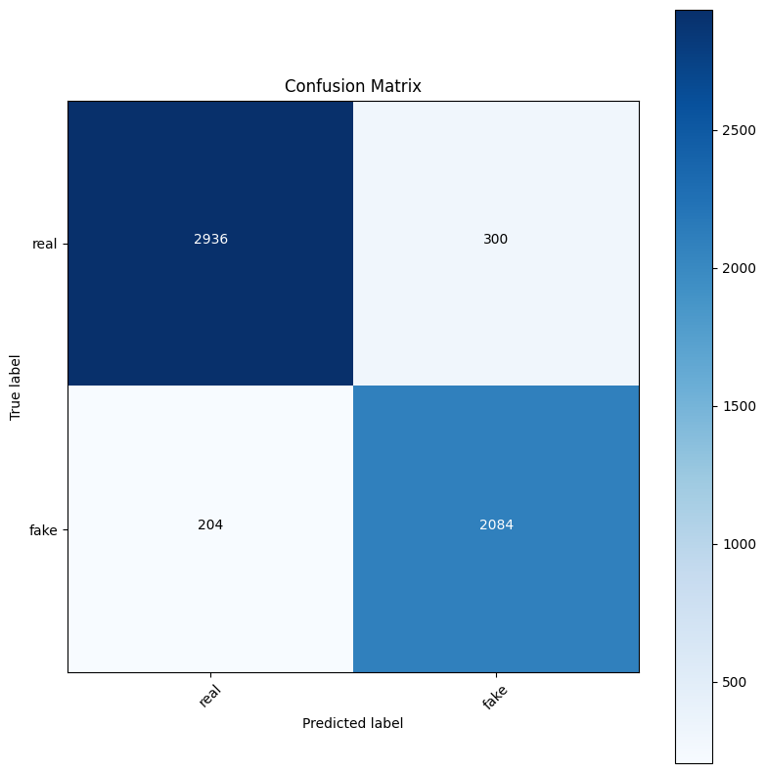
MesoNet Confussion Matrix

Slide 19
Comparison of Results
MesoNet
EfficientNet

Slide 20
Demo

Slide 21



